Slide 1
Wireshark w/Cable
yintao_ling

Slide 2
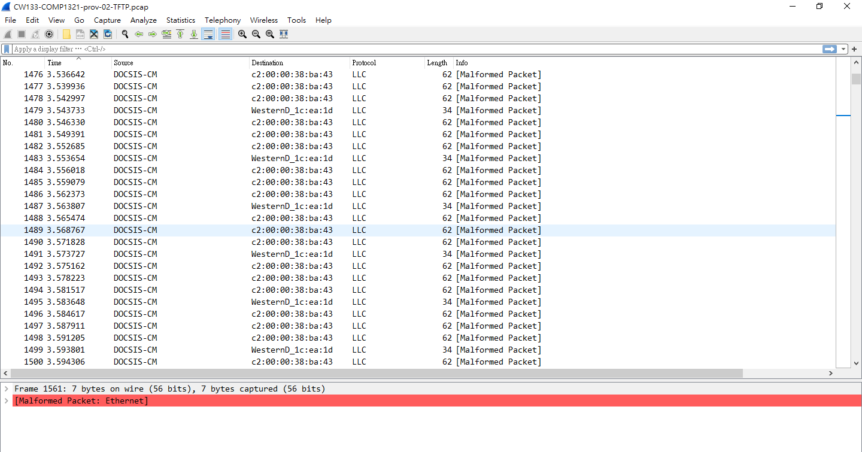
DOCSIS Packet

Slide 3
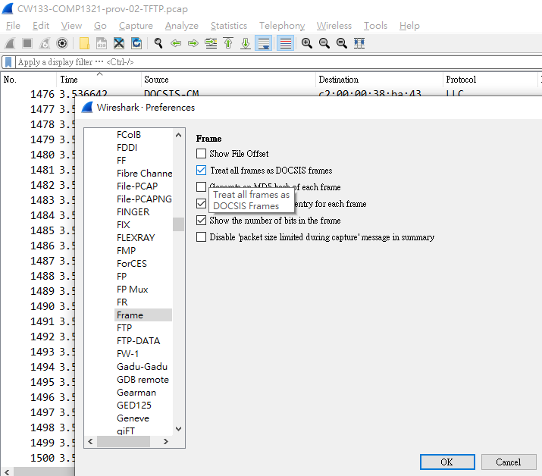
DOCSIS Packet
Edit > Preferences > Protocols > Frame
Treat all frames as DOCSIS frames

Slide 4
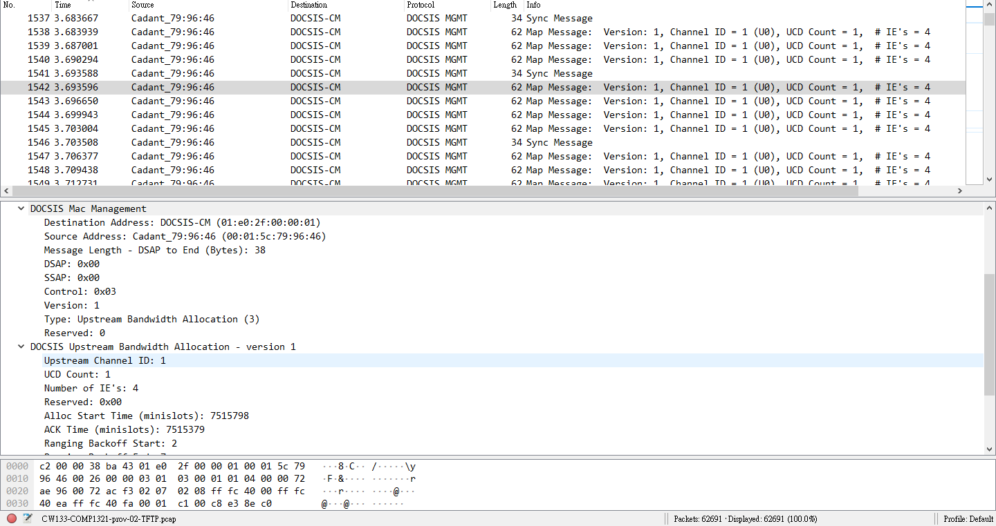
DOCSIS Packet

Slide 5
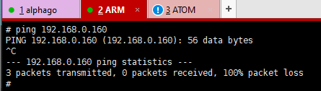
Wireshark on Cable
We can produce DOCSIS pcap file from tcpdump.
In ARM side, only /var/tmp and /tmp are writable.
Puma7 ARM side controls CM / MTA, which eRouter is not accessable.
TFTP Wireshark file from ARM to Atom(LAN User) is no way.
We need to send pcap file from wan0 to RD subnet (172.16.0.0/23).

Slide 6
Wireshark on Cable
ARM
tcpdump -i wan0 -w /tmp/123.pcap
RD Desktop
Check your RD interface is online.
Start your TFTP Server.
ARM
Check your wan0 interface is online.
cd /tmp
tftp -p -l 123.pcap 172.16.0.63

Slide 7
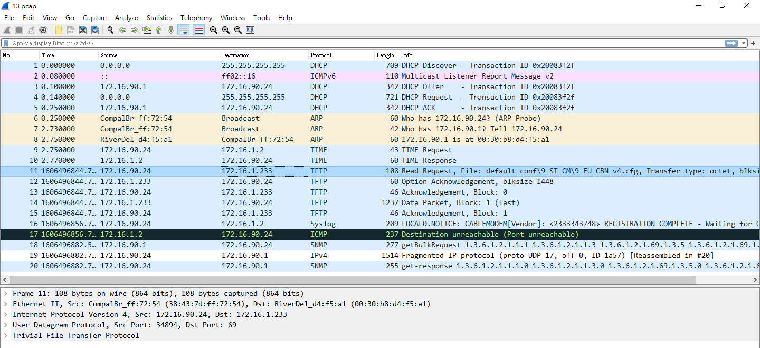
Wireshark on Cable

Slide 8
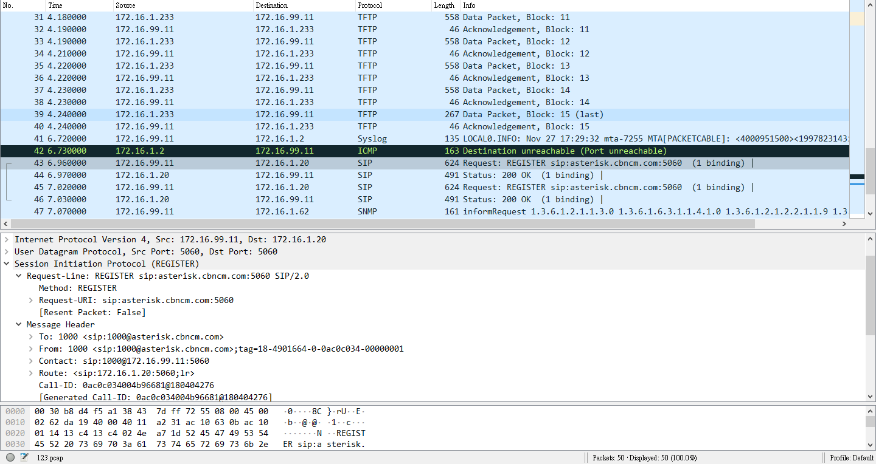
Wireshark on Cable

